Slide 1
PRESCRIPTO ~quick health

Slide 2
MADANAPALLE INSTITUTE OF TECHNOLOGY AND SCIENCE
Department of Computer Science And Engineering
PRESCRIPTO
Guided By MRS. FARHEEN FARHATH
Presented By G. Lahari

Slide 3
PROBLEM STATEMENT
Current Issues in Doctor Booking :
Long waiting times in clinics
Difficulty in finding the right specialist
Lack of a centralized booking system
Need for Solution:
Patients require a fast, reliable, and
user-friendly appointment booking system.

Slide 4
Introduction What is Prescripto ?
A web-based platform to book appointments with doctors easily and quickly. Purpose:
To connect patients and healthcare providers on one platform.
Key Features:
Search & filter doctors
Book appointments online
View appointment history

Slide 5
OBJECTIVES
Build a platform to bridge patients & doctors.
Reduce waiting times.
Provide appointment history & reminders.
Support online consultations.

Slide 6
System Architecture
Frontend:
React.js / HTML / Tailwind CSS / JavaScript
Backend:
Node.js with Express.js
Database: MongoDB (MongoDB Atlas)

Slide 7
Features
User Features:
Register & login
Search doctors by specialty
cancel appointments
View past appointments
Doctor Features:
Manage profile & availability
Accept / reject appointments
Admin Features:
Manage users and doctors
View analytics

Slide 8
Technology Stack
Layer Technology Used
Frontend React.js, Tailwind CSS
Backend Node.js, Express.js Database MongoDB Atlas
Tools Postman and VS Code

Slide 9
Workflow
User signs up / logs in
User searches for a doctor
User selects time & books appointment
Doctor gets notified
Appointment status updated in the system

Slide 10
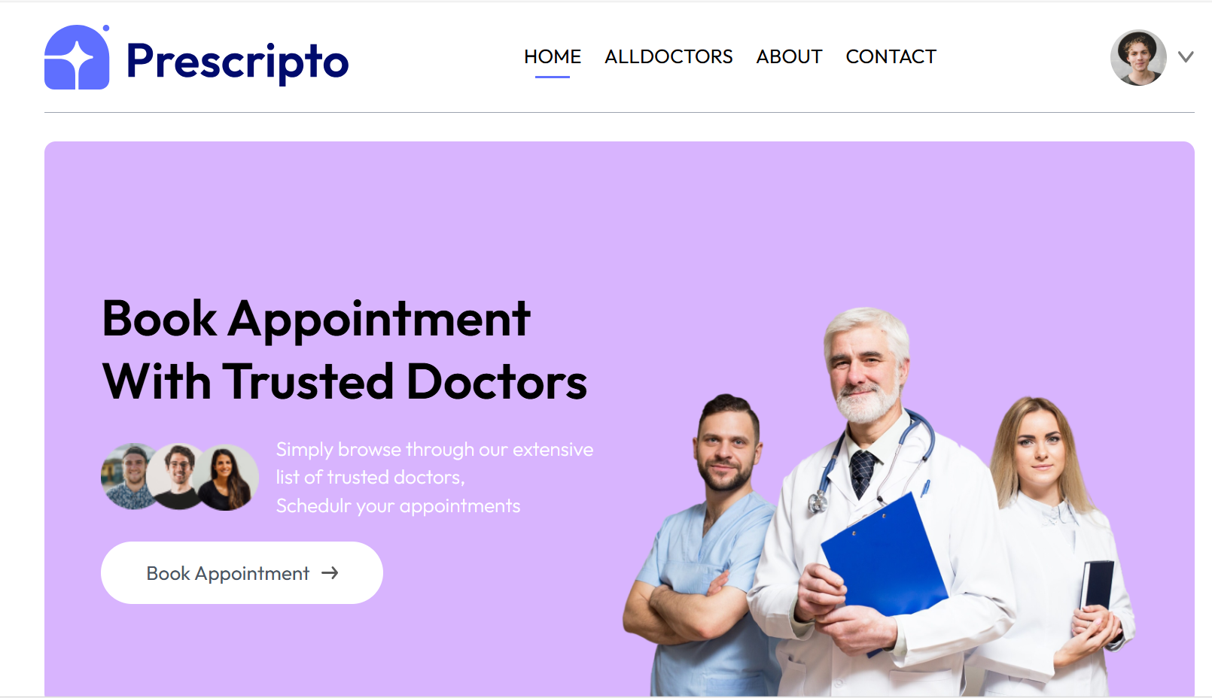
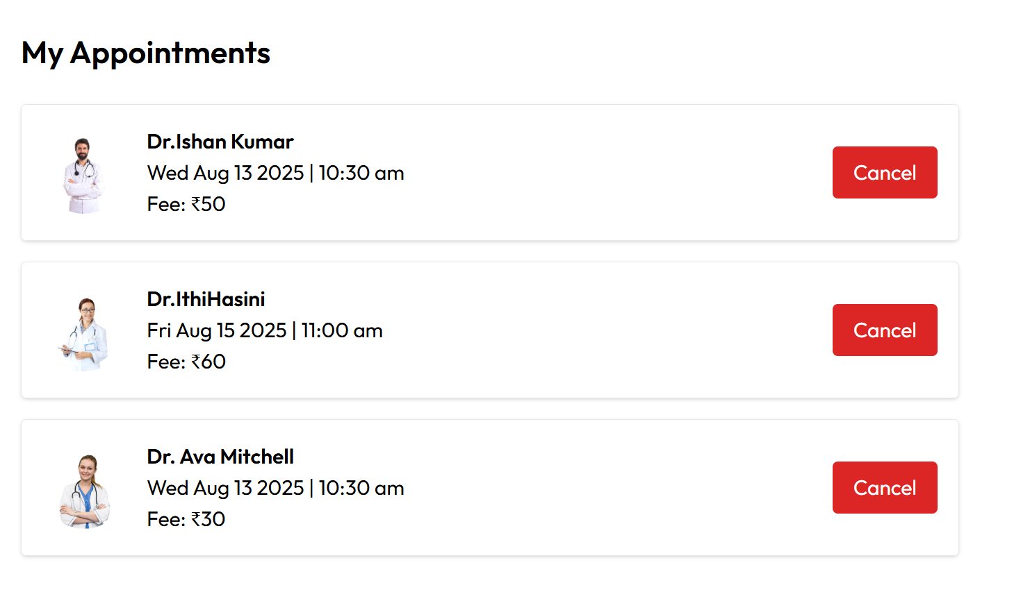
Demo

Slide 11
Advantages
Saves time for both patients & doctors
Reduces paperwork
Improves patient satisfaction
Works 24/7 from anywhere

Slide 12
FUTURE ENHANCEMENTS
Online payment integration
AI-based doctor recommendations
Video consultation feature
Multi-language support

Slide 13
Conclusion
Prescripto aims to revolutionize the doctor appointment process.
Combines convenience, speed, and accessibility.
Has potential for further scalability and features.

Slide 14

THANK YOU

